Slide 1
CS 589 Fall 2021 Lecture 5
Learning to rank
Monday 6:30-9:00
Babbio 122
All zoom links in Canvas
Slides adapted from Stanford CS276
photo: https://www.scubedstudios.com/information-retrieval/
Notes:
In this lecture, we will be talking about probabilistic ranking models, which is

Slide 2
A Brief History of IR
1958
Cranfield evaluation methodology; word-based indexing
300 BC
1960s
building IR systems on computers; relevance feedback
Callimachus: the first library catalog
1970s
TF-IDF; probability ranking principle
1980s
TREC; learning to rank; latent semantic indexing
1950s
1990 - now
web search; supporting natural language queries;
Punch cards, searching at 600 cards/min
Notes:
In today’s lecture, we will be talking about probabilistic ranking principle, and probabilistic retrieval models such as the BM25 model, which was first introduced in the 1970s. BM25 was a ranking model based on probabilistic theory. As of today, it’s still one of the most major ranking models that people would choose to implement for their systems, due to its simplicity and competitive performance.

Slide 3
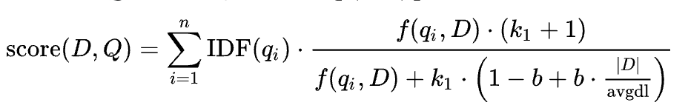
Review of Lecture 1-3: Parameter estimation
Parameter estimation:
TF-IDF, RSJ: no parameter
BM25: use pre-defined values b=0.75, k1 in [1.2, 2.0]
Language model-based retrieval model
Dirichlet smoothing: Newton’s 2nd order method, leave-one-out
JM smoothing: EM algorithm
How to make use of user clicks and user information, e.g., age, gender, to help improve the retrieval performance?
Notes:
Before we begin today’s lecture, let’s first review what we learned from the last lecture. We learned that each document and each query can be represented as a vector in the same space. To retrieve a document from a query, we compute the similarity score as the dot product between the document and query vector. It is important to leverage the inverse document frequency to penalize the weight of stop words such as “the” and “a”.

Slide 4
Review of Lecture 1-3: Parameter estimation
$400, 20G, Nokia
$500, 30G, Nokia
$600, 40G, iphone
query = “best phone”
observed click
session 1
session 2
The new query should match more relevant documents and fewer non-relevant documents
Notes:
we use Google playstore data as the data source, so we collect these data, we clean it, we split the sentence, and we build a filtering algorithm to select the high quality sentence

Slide 5
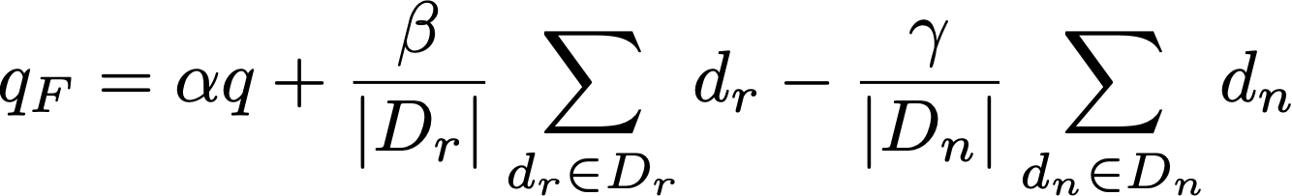
Relevance feedback with the Rocchio’s model
rel docs
non-rel docs
beta >> gamma
Notes:
we use Google playstore data as the data source, so we collect these data, we clean it, we split the sentence, and we build a filtering algorithm to select the high quality sentence

Slide 6
Pop quiz (Inverted Index)
1. Which of the following are prefix encodings, i.e., there does NOT exists a sequence such that there are more than one ways to decode it?
A. {a: 1, b:11, c:0}
B. {a: 0, b: 10, b: 110, c:111}
C. {a: 0, b: 100, c: 101, d: 11}
D. {a: 0, b: 100, c: 10, d: 11}
Notes:
we use Google playstore data as the data source, so we collect these data, we clean it, we split the sentence, and we build a filtering algorithm to select the high quality sentence

Slide 7
Pop quiz (Inverted Index)
2. When we use the following two pointer algorithm to merge the following posting lists, select all documents that will be skipped. Can you implement the two pointer algorithm with Python?
List A:
2
4
8
16
19
23
28
43
90
91
List B:
1
2
3
5
8
41
51
60
72
81
Notes:
we use Google playstore data as the data source, so we collect these data, we clean it, we split the sentence, and we build a filtering algorithm to select the high quality sentence

Slide 8
Pop quiz (Inverted Index)
3. What is the gamma code of 14?
Notes:
we use Google playstore data as the data source, so we collect these data, we clean it, we split the sentence, and we build a filtering algorithm to select the high quality sentence

Slide 9
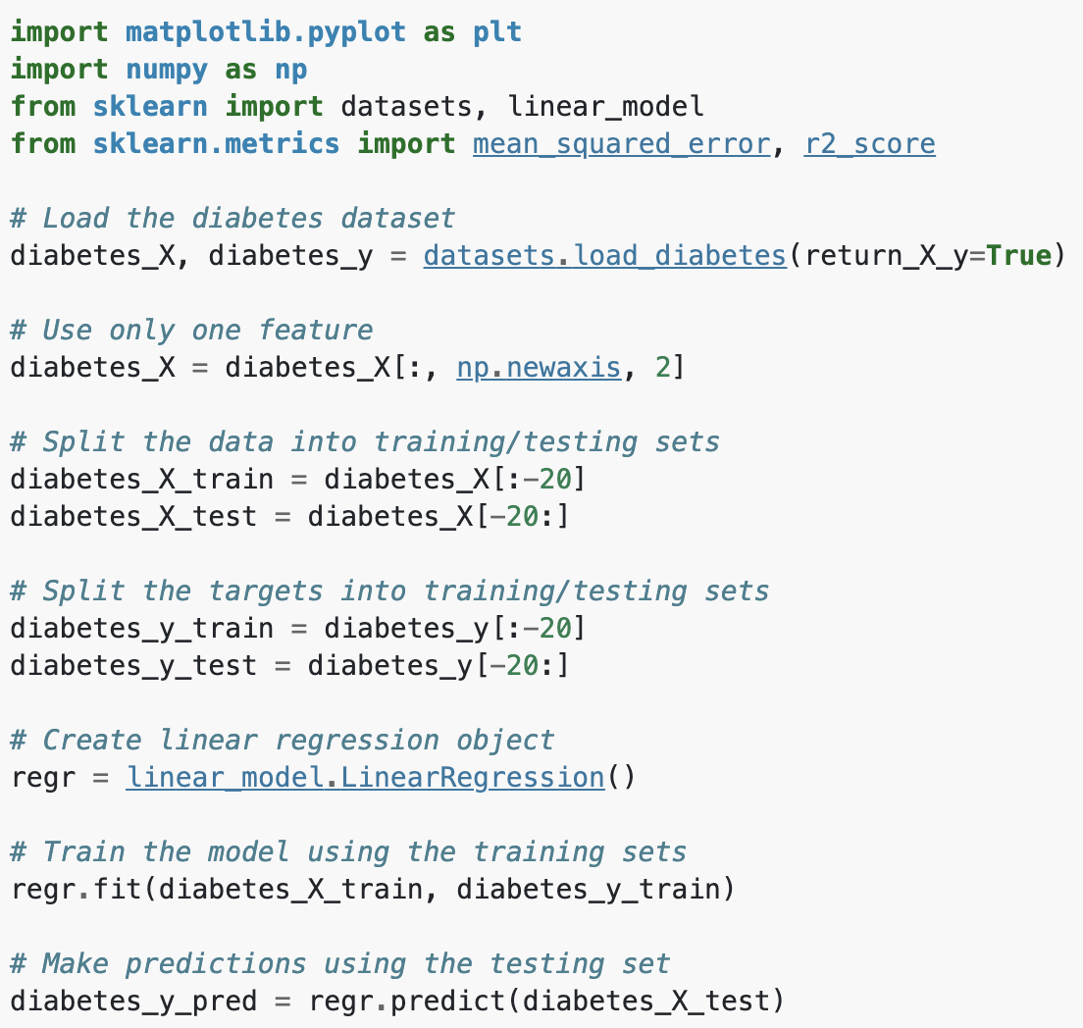
Background: machine learning for diabetes prediction
Input features: X
Output label: y
Notes:
we use Google playstore data as the data source, so we collect these data, we clean it, we split the sentence, and we build a filtering algorithm to select the high quality sentence

Slide 10
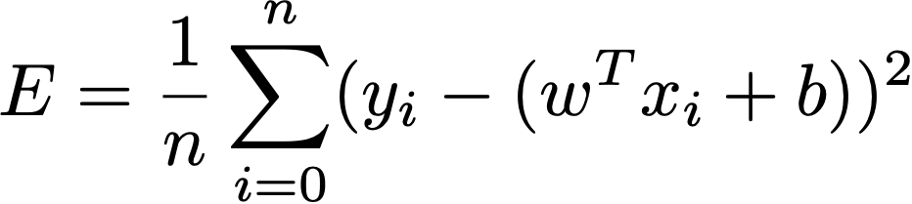
Background: linear regression
The relationship between input feature and output label is modeled using a linear predictor
Disadvantage: cannot model non-linear relationships
X
Notes:
we use Google playstore data as the data source, so we collect these data, we clean it, we split the sentence, and we build a filtering algorithm to select the high quality sentence

Slide 11
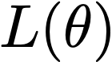
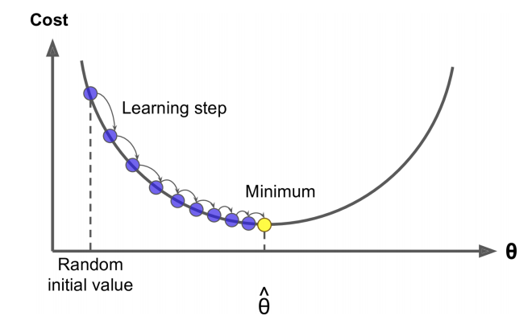
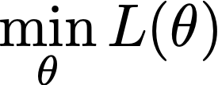
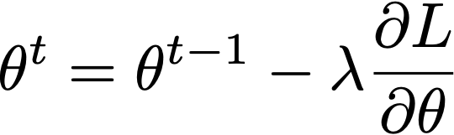
Background: gradient descent (optimization method)
We have a cost function we want to minimize
There are a list of optimization algorithm (for both convex and non-convex objectives), the most popular one is gradient descent (first-order optimization)
At each iteration, GD calculate gradient of , then take small step in direction of negative gradient
Notes:
we use Google playstore data as the data source, so we collect these data, we clean it, we split the sentence, and we build a filtering algorithm to select the high quality sentence

Slide 12

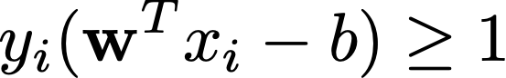
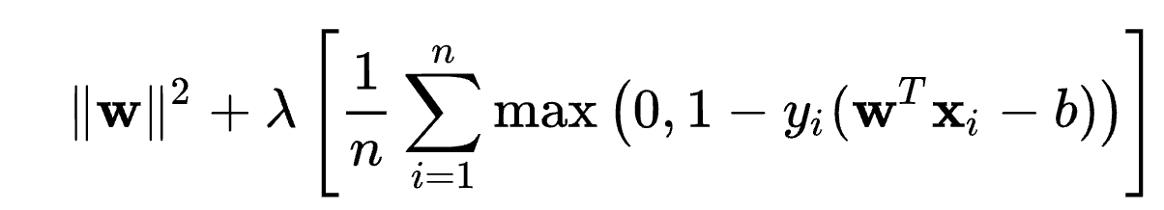
Background: support vector machine (SVM)
Hard-margin: find the hyperplane that maximizes the margin between the support vectors (i.e., samples on the margin)
Minimize s.t.
Soft-margin: minimize hinge loss
Notes:
we use Google playstore data as the data source, so we collect these data, we clean it, we split the sentence, and we build a filtering algorithm to select the high quality sentence

Slide 13
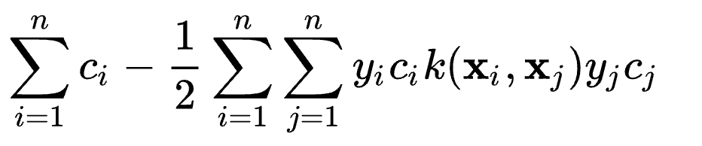
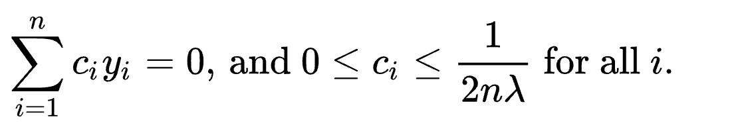
Background: support vector machine (SVM)
Hard-margin: find the hyperplane that maximizes the margin between the support vectors (i.e., samples on the margin)
Minimize s.t.
Soft-margin: minimize hinge loss
Capture non-linearity with kernel (dual form):
Minimize
s.t.
Notes:
we use Google playstore data as the data source, so we collect these data, we clean it, we split the sentence, and we build a filtering algorithm to select the high quality sentence

Slide 14
Using machine learning to help improve IR
Training features:
Retrieval model score: cosine similarity, IDF, BM25, proximity, pivoted document length normalization, PageRank, …
User demographic information: User age, gender
User search history
Training labels
User clicks
Other user activities (e.g., purchase record, SAT clicks)
Notes:
we use Google playstore data as the data source, so we collect these data, we clean it, we split the sentence, and we build a filtering algorithm to select the high quality sentence

Slide 15
Machine learning for IR came in late
This “good idea” has been actively researched – and actively deployed by major web search engines in the past 10 years, e.g., XGBoost [2016]
Modern supervised learning has been around for 30 years, e.g., SVM [1995], gradient boosting [2003]
Why not earlier?
Limited training data
Poor machine learning techniques
Insufficient customization to IR problem
Not enough features for ML to show value
It was possible to tune parameters by hand (and people did)
Notes:
Especially for real world use (as opposed to writing academic papers), it was very hard to gather test collection queries and relevance judgments that are representative of real user needs and judgments on documents returned
This has changed, both in academia and industry

Slide 16
Learning to rank benefits from web search
Modern (web) systems use a great number of features:
Arbitrary useful features – not a single unified model
Log frequency of query word in anchor text?
Query word in color on page?
# of images on page?
# of (out) links on page?
PageRank of page?
URL length?
URL contains “~”?
Page edit recency?
Page loading speed
The New York Times in 2008-06-03 quoted Amit Singhal as saying Google was using over 200 such features (“signals”) – so it’s sure to be over 500 today. ☺
Notes:
we use Google playstore data as the data source, so we collect these data, we clean it, we split the sentence, and we build a filtering algorithm to select the high quality sentence

Slide 17
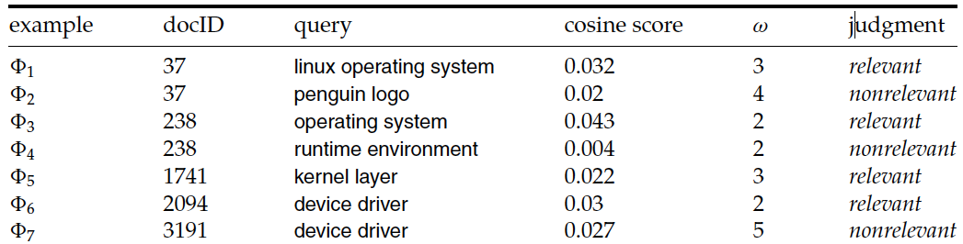
Learning to rank as binary classification
For each (q, d, r) triples:
Output label y = Relevance judgment (binary)
Input feature x = (α, ω):
α is cosine similarity of the vector space model
ω is minimum query window size in the document
Training: apply supervised classification on x and y for training data
Prediction: use the predicted label for retrieval (1=relevant, 0=nonrelevant)
Notes:
So this linear regression model only contains 3 parameters, alpha and omega

Slide 18
Learning to rank as binary classification
0.05
R
Decision surface
R
N
cosine score α
R
R
R
R
R
N
N
0.025
R
R
R
R
N
N
N
N
N
N
N
0
2
3
4
5
Term proximity ω
Notes:
So this linear regression model only contains 3 parameters, alpha and omega

Slide 19
Learning to rank as regression
For each (q, d, r) triples:
Output label y = Relevance judgment, multi-level
Input feature x = (α, ω):
α is the cosine similarity of the vector space model
ω is minimum query window size in the document
Training: apply linear regression on x and y
Ranking: use the predicted score for ranking
1
2
1
3
1
3
2
Notes:
So this linear regression model only contains 3 parameters, alpha and omega

Slide 20
Learning to rank as regression
Linear model
cosine score α
Relevance level
Term proximity ω
Notes:
So this linear regression model only contains 3 parameters, alpha and omega

Slide 21
Challenge in relevance judgment
Exact judgment for relevance is challenging
Exact judgment is incomparable across sessions
The criterion for relevance judgment may drift over time
Relative judgment is easier
i.e., for docID 2094 and 3191, only consider the “weak supervision” that 2094 is more relevant than 3191 (instead that 2094’s relevance is exactly 3)
1
2
1
3
1
3
2
Notes:
So this linear regression model only contains 3 parameters, alpha and omega

Slide 22
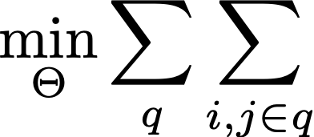


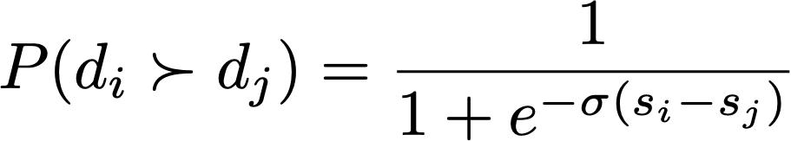
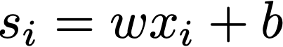
Pairwise learning to rank
Leveraging the relative relevance judgment, i.e., pairwise labels
Loss function: cross entropy loss
Pairwise objective
Probability that di is more relevant than dj
Notes:
we use Google playstore data as the data source, so we collect these data, we clean it, we split the sentence, and we build a filtering algorithm to select the high quality sentence

Slide 23
Ranking based on machine learning algorithms
Support Vector Machines (Vapnik, 1995)
Adapted to ranking: Ranking SVM (Joachims 2002)
Neural Nets: RankNet (Burges et al., 2006)
Tree Ensembles
Random Forests (Breiman and Schapire, 2001)
Boosted Decision Trees
Multiple Additive Regression Trees (Friedman, 1999)
Gradient-boosted decision trees: LambdaMART (Burges, 2010)
Used by all search engines? AltaVista, Yahoo!, Bing, Yandex, …
All top teams in the 2010 Yahoo! Learning to Rank Challenge used combinations with Tree Ensembles!
Notes:
we use Google playstore data as the data source, so we collect these data, we clean it, we split the sentence, and we build a filtering algorithm to select the high quality sentence

Slide 24
Yahoo! learning to rank challenge
Chapelle and Chang [2011]
Yahoo! Webscope dataset : 36,251 queries, 883k documents, 700 features, 5 ranking levels
Ratings: Perfect (navigational), Excellent, Good, Fair, Bad
Real web data
set-1: 473,134 feature vectors; 519 features; 19,944 queries
set-2: 34,815 feature vectors; 596 features; 1,266 queries
Winner (Burges et al. 2011) was linear combo of 12 models:
8 Tree Ensembles (LambdaMART)
2 LambdaRank Neural Nets
2 Logistic regression models
Notes:
we use Google playstore data as the data source, so we collect these data, we clean it, we split the sentence, and we build a filtering algorithm to select the high quality sentence

Slide 25
Yahoo! learning to rank challenge
Goal was to validate learning to rank methods on a large, “real” web search problem
Previous work was mainly driven by LETOR datasets
Great as first public learning-to-rank data
Small: 10s of features, 100s of queries, 10k’s of docs
Only feature vectors released
Not URLs, queries, nor feature descriptions
Wanting to keep privacy and proprietary info safe
But included web graph features, click features, page freshness and page classification features as well as text match features
Notes:
we use Google playstore data as the data source, so we collect these data, we clean it, we split the sentence, and we build a filtering algorithm to select the high quality sentence

Slide 26
Regression tree
Regression tree are decision trees that can predict a value
decision tree
regression tree
Notes:
we use Google playstore data as the data source, so we collect these data, we clean it, we split the sentence, and we build a filtering algorithm to select the high quality sentence

Slide 27
Regression tree
Splitting criterion: Standard Deviation Reduction
Choose split value to minimize the variance (standard deviation) of the values in each child induced by split $A$ (normally just a binary split for easy search):
Termination: cutoff on SD or #examples or tree depth
Notes:
we use Google playstore data as the data source, so we collect these data, we clean it, we split the sentence, and we build a filtering algorithm to select the high quality sentence

Slide 28
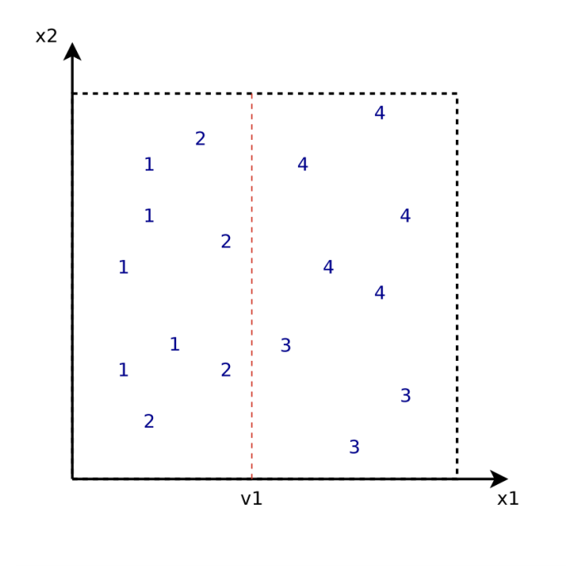
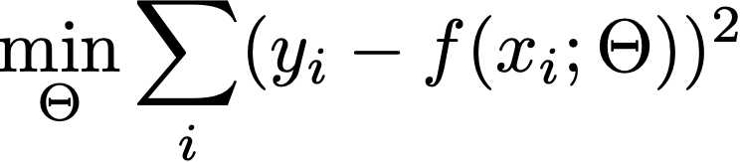
Training a regression tree
x^1 < v1
v4
x^1 > v3
x^2 < v4
1.444
3.625
v3
2
1.5
3
4
Notes:
we use Google playstore data as the data source, so we collect these data, we clean it, we split the sentence, and we build a filtering algorithm to select the high quality sentence

Slide 29
Boosting in machine learning (AdaBoost)
AdaBoost: using the ensemble of multiple weak learners to build a high accuracy classifier
Weak learners = small decision trees (1-split decision stumps)
Weights for each learner and instance
Instances are weighed on probability it’s mistaken
Learners are weighed on its accuracy
Error of the weak learner
Notes:
Repeat:
Upweight examples it gets wrong;
Downweight examples it gets right
Learn another small decision tree on that reweighted data
Classify with weighted vote of all trees
Weight trees by individual accuracy

Slide 30
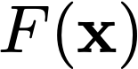
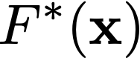
Towards gradient boostings
Linear regression finds the parameter that minimizes the square loss:
Gradient boosting finds the function that minimizes the expected square loss:
Gradient boosting approximate with additive expansion, i.e., boosting:
$$F\left(x\right)=\sum_{m=1}^{M}{β_{m}h(x;a_{m})}$$
Parameter of h
Notes:
h(x; a) are simple functions of x with parameters a = {a1, a2, …, an} defining the function h, and the β are weighting coefficients

Slide 31
Gradient boosting: estimating the parameter
Function parameters are iteratively fit to the training data:
Set F₀(x) = initial guess (or zero)
For each m = 1, 2, …, M
$$a_{m}=\arg{{\text{min}}_{a}\sum_{i}{L(y_{i},F_{m−1}\left(x_{i}\right)+βh\left(x_{i},a\right))}}$$
$${F_{m}\left(x\right)=F}_{m−1}\left(x_{i}\right)+βh\left(x_{i},a\right)$$
You successively estimate and add a new tree to the sum
You never go back to revisit past decisions
Notes:
h(x; a) are simple functions of x with parameters a = {a1, a2, …, an} defining the function h, and the β are weighting coefficients

Slide 32
Gradient boosting: estimating the parameter
Fit the function h(x; a) by least squares
$$a_{m}=\arg{{\text{min}}_{a}}\sum_{i}{{[{\overset{\sim }{y}}_{im}−h(x_{i},a)]}^{2}}$$
to the “pseudo-residuals” (deviation from desired scores)
$${\overset{\sim }{y}}_{im}=−{\left[\frac{∂L(y_{i},F\left(x_{i}\right))}{∂F(x_{i})}\right]}_{F\left(x\right)=F_{m−1}(x)}$$
The name “gradient boosting” is because the gradient is equal to residual, i.e., we are using the gradient to improve the model
Each h function is a small tree, e.g., a stump with depth = 1
Notes:
The reason it’s called gradient boosting is that the residual is exactly equal to the gradient, so we are using the gradient to improve the model for each iteration

Slide 33
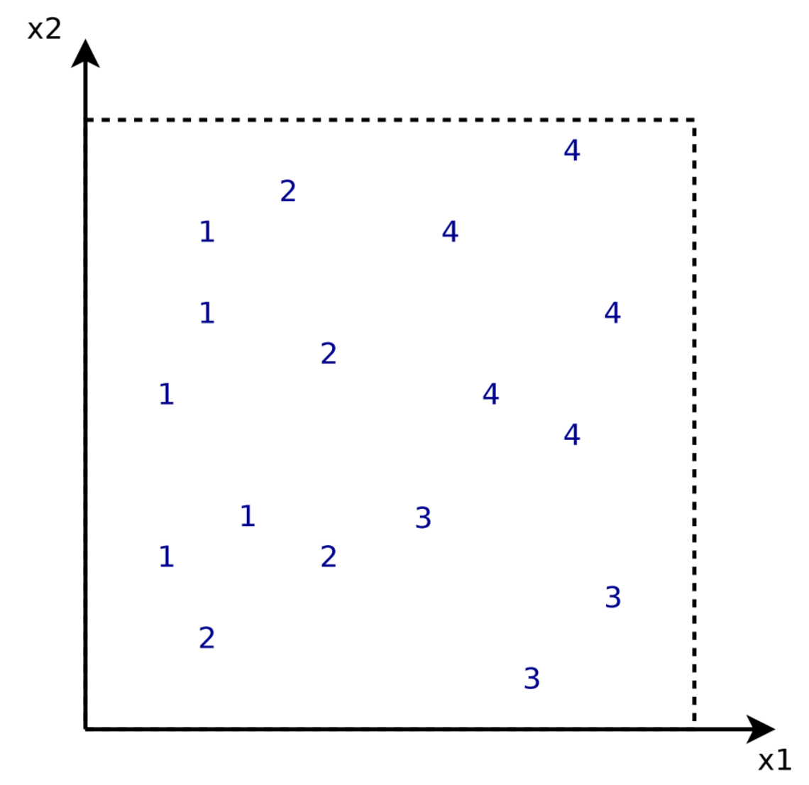
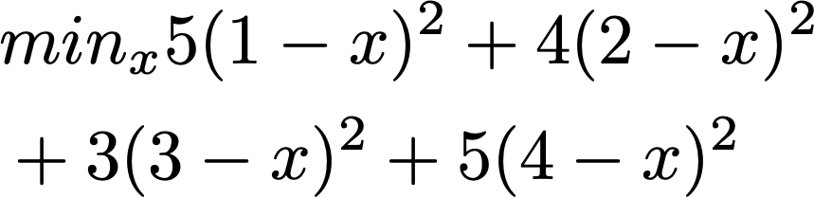

Gradient boosting regression tree example
In the first iteration, predict a constant value that minimizes the loss: f0(x) = mean value
f0(x)
2.471
Notes:
First, learn the simplest predictor that predicts a constant value that minimizes the error on the training data

Slide 34
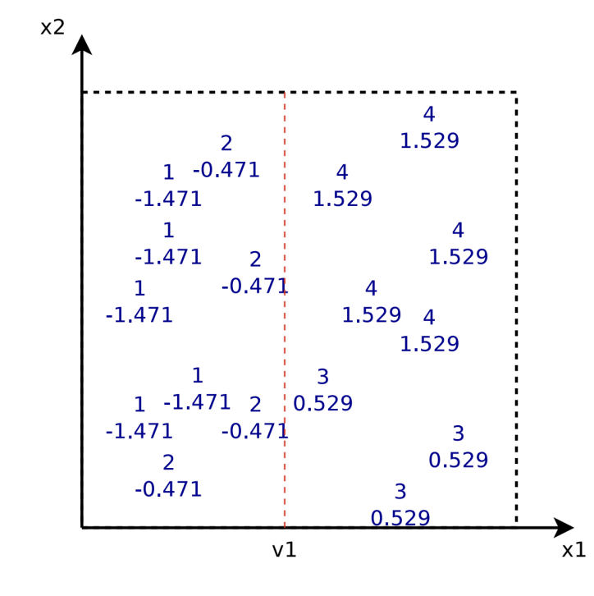
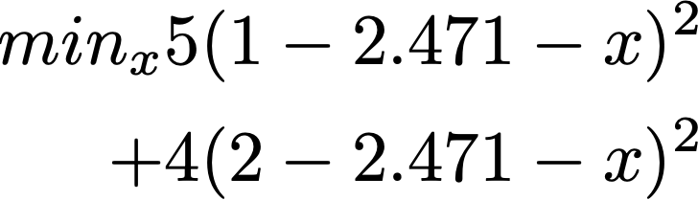
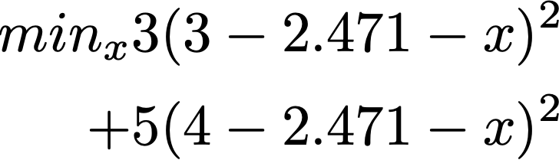
Gradient boosting regression tree example
After the first iteration, update each value as the new residual (subtracting 2.471), then train a regression tree to minimize the loss
f1(x)
f0(x)
x1 < v1
2.471
-1.027
1.154
Notes:
We split root node based on least squares criterion and build a tree predicting “pseudo-residuals”

Slide 35
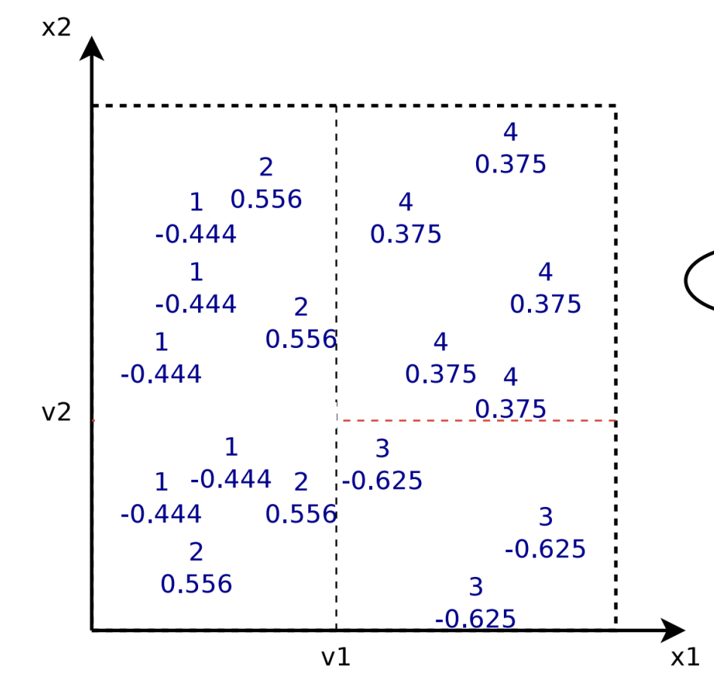
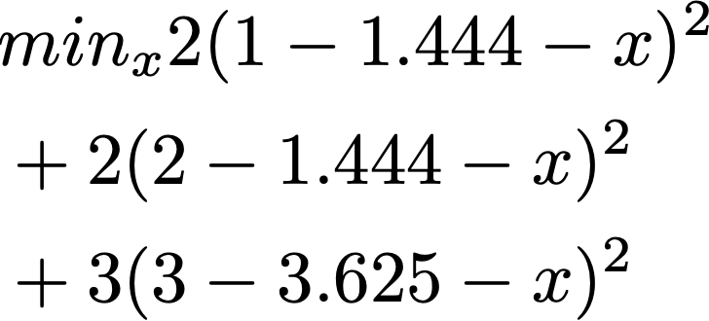
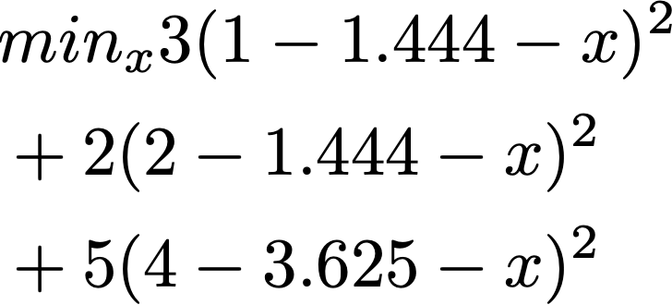
Gradient boosting regression tree example
After the second iteration, update each value as the new residual, then train a regression tree to minimize the loss
f2(x)
x2 < v2
-0.236
0.166

Slide 36
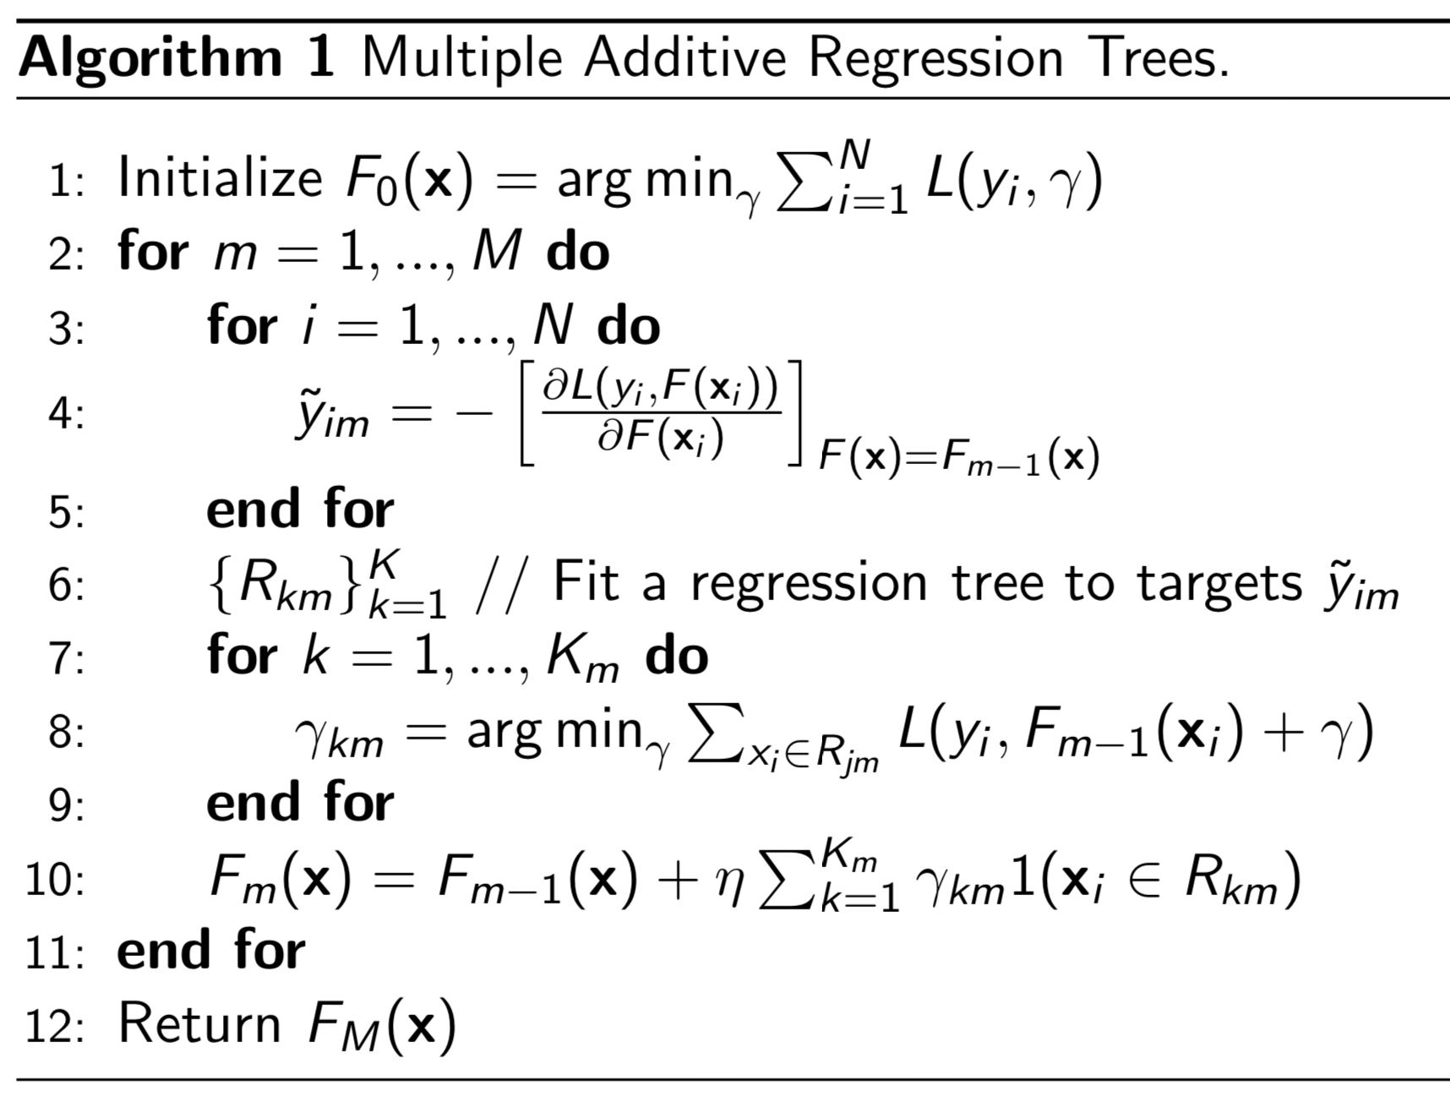
Multiple additive regression tree [Friedman 1999]
f0(x)
f1(x)
Prediction =
2.471
+
x1 < v1
-1.027
1.154
f2(x)
+
x2 < v2
+ …
-0.236
0.166

Slide 37
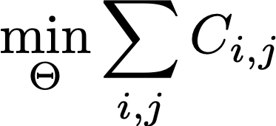
RankNet [Burges et al. 2010]
Use si to denote the ranking function:
Plugging in the probability gives rise to:
Sij = 1 if di is more relevant than dj; –1 if the reverse, and
0 if the they have the same label
Notes:
we use Google playstore data as the data source, so we collect these data, we clean it, we split the sentence, and we build a filtering algorithm to select the high quality sentence

Slide 38
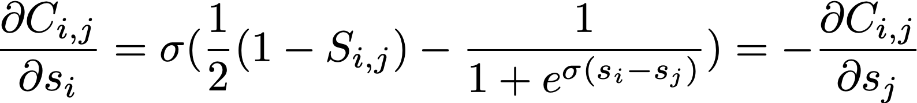
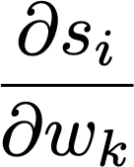
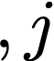

RankNet [Burges et al. 2010]
Take the gradient of C_i,j w.r.t. w_k:
{i, j} in I: for all pairs of i, j in the data (both positive and negative)
Notes:
we use Google playstore data as the data source, so we collect these data, we clean it, we split the sentence, and we build a filtering algorithm to select the high quality sentence

Slide 39
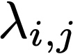
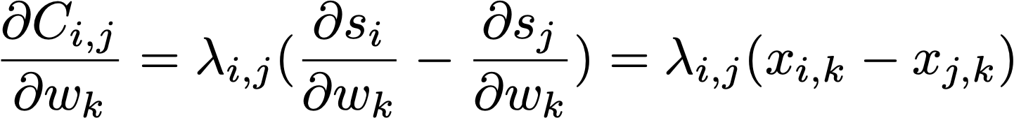
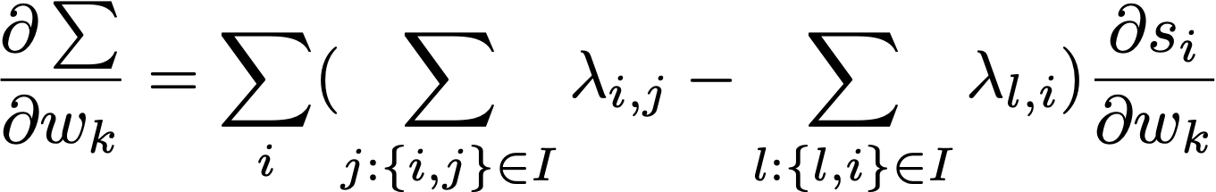
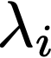
RankNet [Burges et al. 2010]
describes the desired change of scores for the document pair di and dj:
The sum of all λ_{ij} ’s and λ_{ji} ’s of a query-doc vector x_{i} w.r.t. all other differently labelled documents for q (turned the pairwise loss into a point-wise form)
Therefore, is sort of a “gradient” w.r.t. document di under query q
Constant given di,dj
Notes:
describes the desired change of scores for the document pair di and dj,

Slide 40
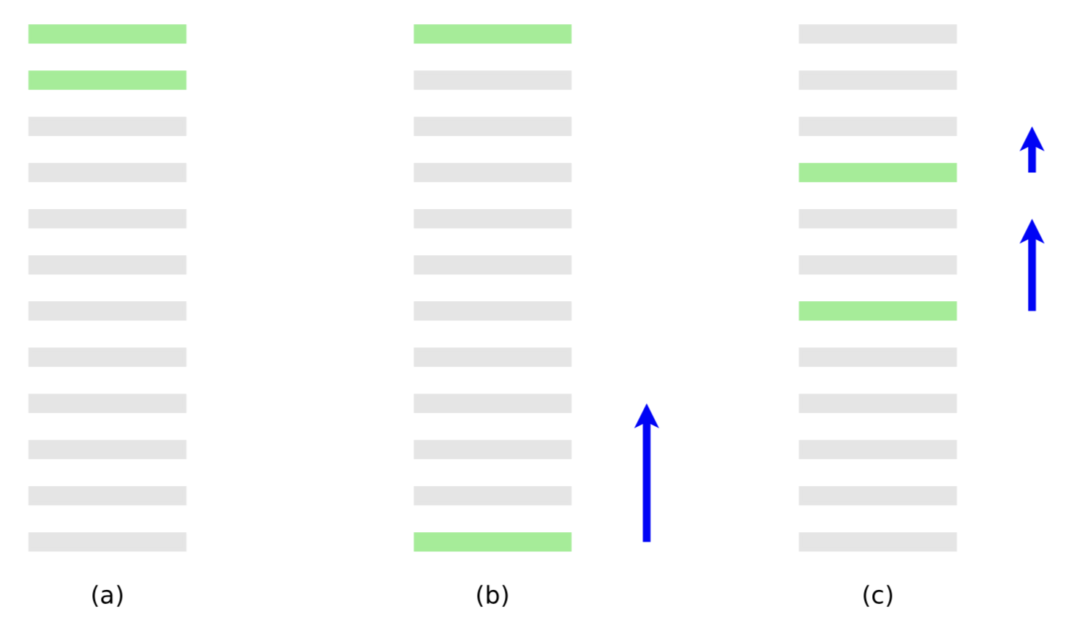
RankNet [Burges et al. 2010]
Interpreting : (a) is the perfect ranking, (b) is a ranking with 10 pairwise errors, (c) is a ranking with 8 pairwise errors. Each blue arrow represents the λ_{i} for each query-document vector x_{i}
Notes:
The optimization algorithm should find the w_k such that it makes this document go a little higher, and so for this and this document. But this document should go above more than this and this document

Slide 41
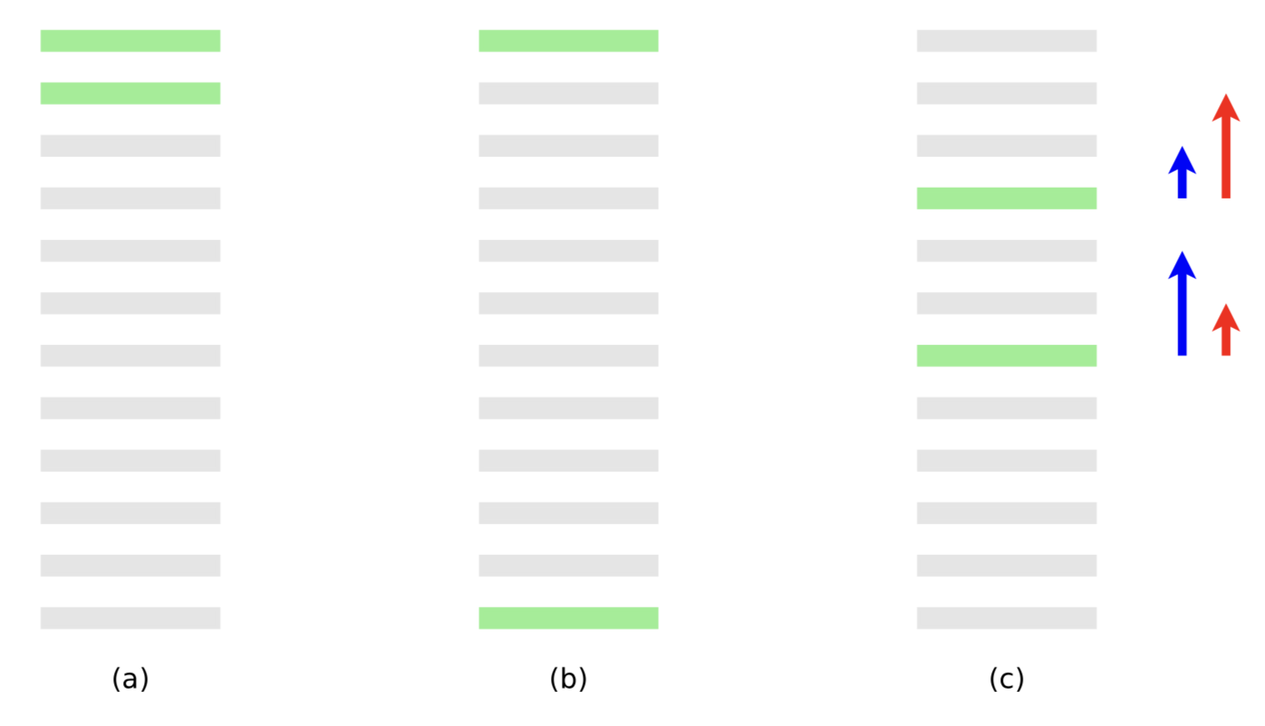
RankNet [Burges et al. 2010]
RankNet minimizes the entropy loss, alternatively we can directly optimize the evaluation metrics, e.g., MAP [2007], NDCG [2010] and MRR
Modern web search tends to emphasize better precision at a higher position
Which metrics to use for emphasizing performance at a higher position?
Notes:
The optimization algorithm should find the w_k such that it makes this document go a little higher, and so for this and this document. But this document should go above more than this and this document

Slide 42
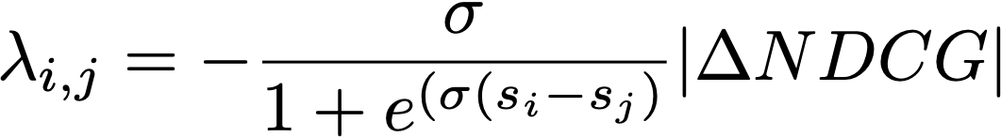
From RankNet to LambdaRank
RankNet has assigned the same weight for all errors
LambdaRank: scale (desired change of scores for the document pair di and d) based on the change in the NDCG score:
Burges et al. “prove” (partly theory, partly empirical) that this change is sufficient for model to optimize NDCG
Notes:
describes the desired change of scores for the pair of documents di and dj

Slide 43
From RankNet to LambdaRank
LambdaRank models gradients
MART can be trained with gradients (“gradient boosting”)
Combine both to get LambdaMART
MART with specified gradients and optimization step
Notes:
describes the desired change of scores for the pair of documents di and dj

Slide 44
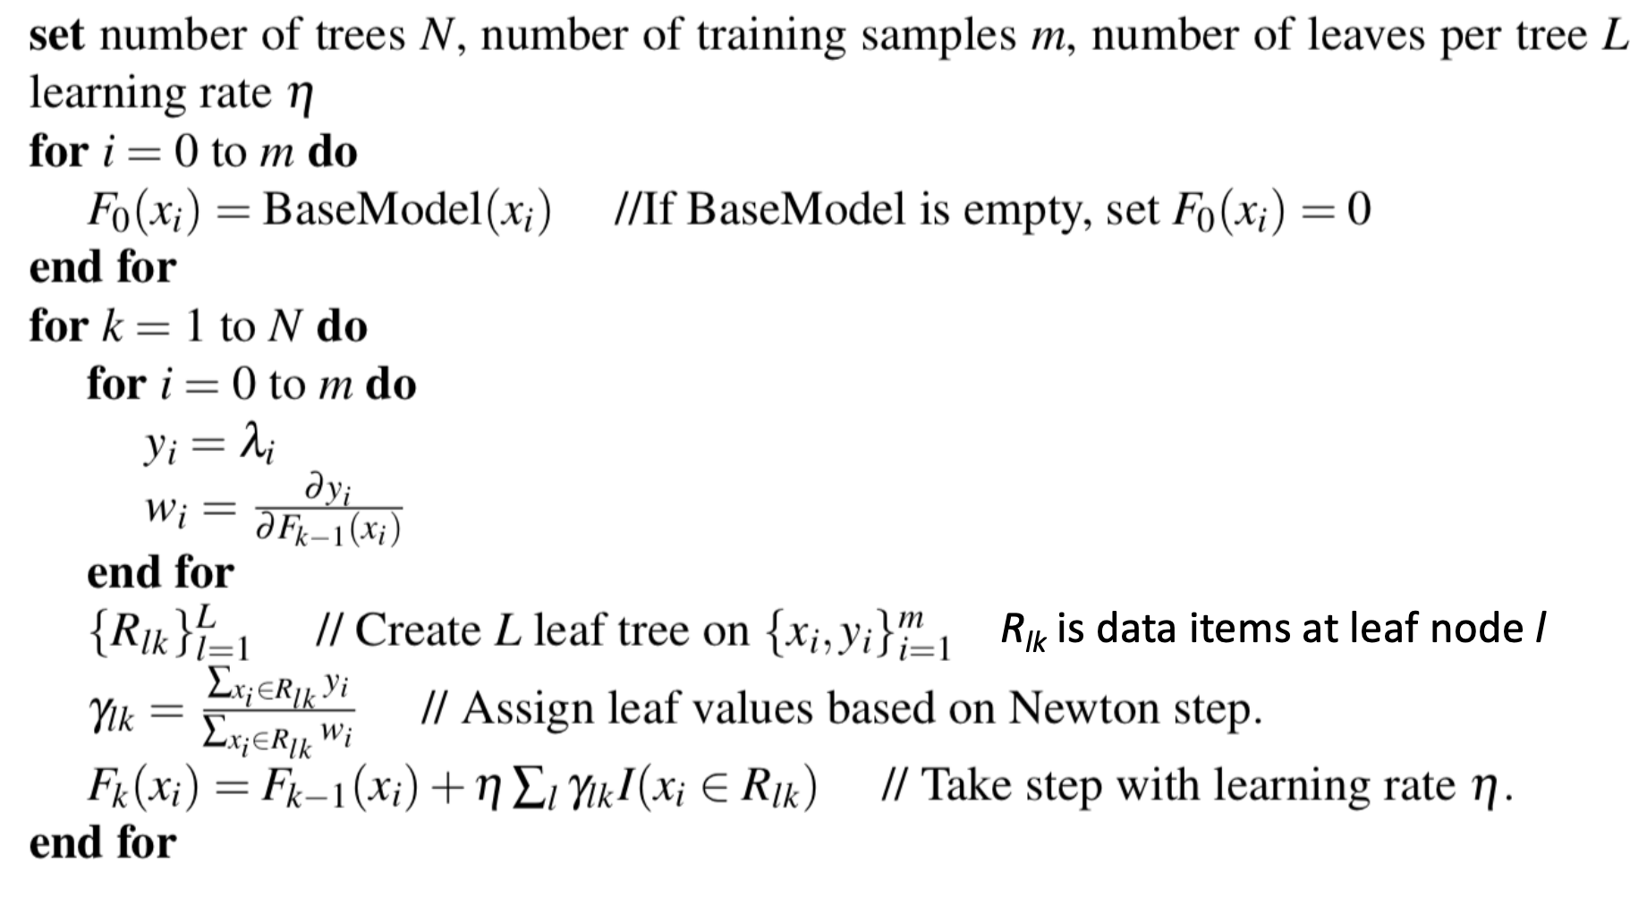
LambdaMART [Burges et al. 2010]
Lambdas are kind of “gradients” in RankNet
In MART, with the specific lambda as gradients, we get:
LambdaMART = LambdaRank + MART (gradient boosting)
Use lambda as the residual for computing the gradient
Gradient boosting
Notes:
we use Google playstore data as the data source, so we collect these data, we clean it, we split the sentence, and we build a filtering algorithm to select the high quality sentence

Slide 45
Learning to rank categorization
Pointwise learning to rank: linear regression, SVM
Pairwise learning to rank: RankNet, lambdaMART
Listwise learning to rank (optimizing the metric score w.r.t. a ranked list): NDCGBoost
 | Algorithm | Category | Description
1992 | Linear reg | Pointwise | Staged logistic regression
1999 | MART | Pairwise | Multiple additive regression tree
2005 | RankNet | Pairwise
2007 | SVM^{map} | Listwise | Optimizing MAP using SVM
2010 | NDCGBoost | Listwise | Optimizing NDCG using boosting
2016 | XGBoost | Pairwise | Support various eval metrics
Notes:
Support various ranking objective and evaluation metrics

Slide 46
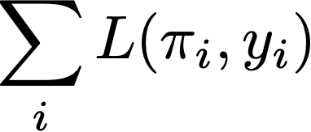
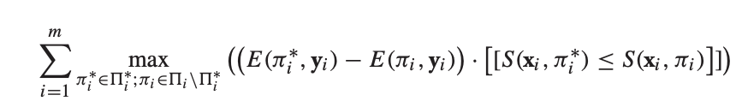
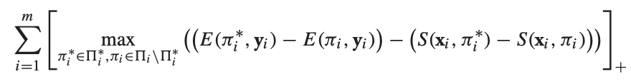
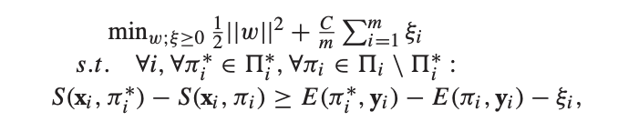

Listwise learning to rank for MAP [Yue et al. 2007]
Listwise learning to rank approach minimizes the loss with respect to the ranked list (e.g., MAP, NDCG)
SVM MAP [Yue et al. 2007]
minimize
Taking upper bound
+: hinge loss
Notes:
For example, utilizing hinge function and taking the true loss as MAP, we obtain SVM MAP.
More precisely, SVM MAP solves the following optimization problem:

Slide 47
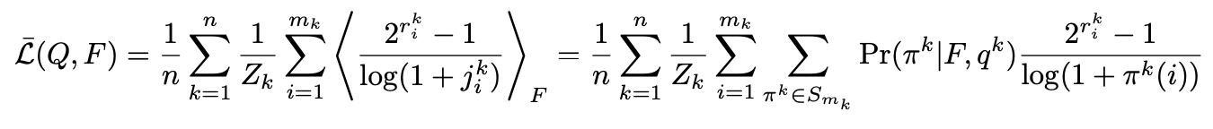
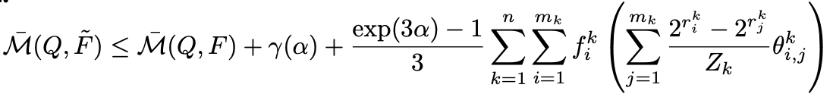
Listwise learning to rank for NDCG [Valizadegan et al. 2009]
Optimizing the NDCG measure:
Directly optimizing the above function is infeasible, so they derived an approximation
Then compute the ranking function by ensemble following a similar approach as boosting
Notes:
Support various ranking objective and evaluation metrics

Slide 48
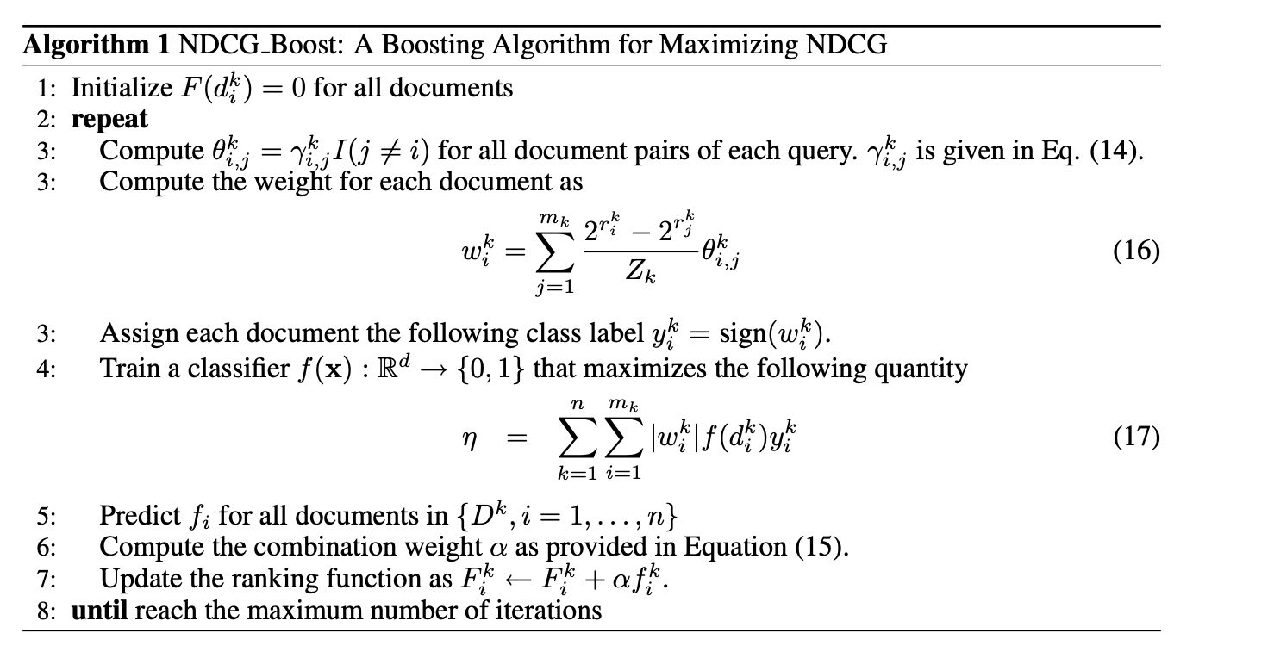
Listwise learning to rank for NDCG [Valizadegan et al. 2009]
Notes:
The magnitude of wki shows how much the corresponding document is misplaced in the ranking. A positive weight wkI indicates that the ranking
position of dki induced by the current ranking function F is less than its true rank position, while a negative weight wki shows that ranking position of d ki induced by the current F is greater than its true rank position.

Slide 49
Summary
The idea of machine learning for ranking has been around for a long time
In the last 2 decades, learning to rank has become a hot topic due to the development of machine learning, the availability of massive amount of user log and the growth in computational power
The mainstream learning to rank algorithms focus on tree ensemble method
Machine-learned ranking over many features now easily beats traditional hand-designed ranking functions by learning the evaluation metrics directly
Notes:
describes the desired change of scores for the pair of documents di and dj

Slide 50
Resources for learning to rank
Ranklib: https://sourceforge.net/p/lemur/wiki/RankLib/
XGBoost: https://github.com/dmlc/xgboost
Yahoo! Learning to rank challenge dataset
C. J. C. Burges. From RankNet to LambdaRank to LambdaMART: An Overview. Microsoft TR 2010.
O. Chapelle and Y. Chang. Yahoo! Learning to Rank Challenge Overview. JMLR Proceedings 2011
Notes:
describes the desired change of scores for the pair of documents di and dj

